Slide 1
Orinoquia River basin vulnerability assessment
Preliminary results
Hydrosystem Research Group, UMass
02-24-2025

Slide 2
Objectives
Assess the vulnerability of the Orinoquia River basin to climate and demand change
Provide insights of potential adaptation or policies to reduce vulnerability and risk
Methods Resilience by Design (Brown et al. 2020)

Slide 3
Schematic of the model chain used for the vulnerability assessment
Climate generator
Cultivated land projections
Population growth projections
Livestock population growth projections
Rainfall
Temperature
PET
Rice
Oil palm trees
Rural
Urban
Chicken
Pigs
Cattle
Irrigation demand
Freshwater rural demand
Freshwater urban demand
Livestock demand
Hydrology
Policies
Orinoquia Water Future (OWF) model
Simulated water deliveries to each users across all 27 sub-basins
River flow downstream each of the considered sub-basins

Slide 4
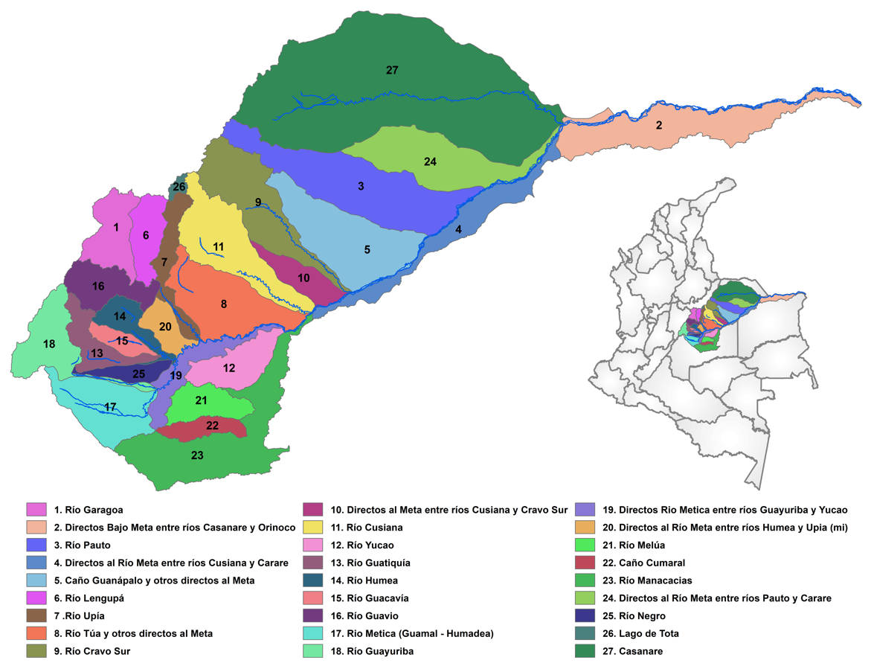
Orinoquia Water Futures’ model
Inputs:
Streamflow time series for each of the 27 sub-basins
Demand (freshwater, irrigation, livestock) time series
Outputs:
Deliveries to each customer types across all 27 sub-basins
Streamflow downstream each sub-basin

Slide 5
Climate Stress Test - Scenarios
A comprehensive sensitivity analysis to change in climate and demand to reveal thresholds or tipping points from which the system is no longer able to reach its objectives
Future climate scenarios (Temp., Rainfall) are obtained by perturbing current climate realizations obtained from the climate generator. Additive factors are used for temperature and multipliers are used for rainfall
Future demand scenarios (freshwater, irrigation and livestock) demand are obtained by linearly extrapolating historical trends. The ‘baseline’ value is the one obtained for the year 2022.
Policy scenarios are used to represent different distribution “strategies” among users.

Slide 6
Policies
First Come First Served (FCFS) This dispatch order is meant to represent the way water is currently allocated to the different users across the basin. This is not the allocation intended by the state government.
Urban customers
Agricultural customers
Livestock customers
Rural customers
Minimum flow requirements not enforced
Policy enforced (PE) This dispatch order is meant to represent the allocation the wants to be respected across the basin:
Minimum flow requirements enforced
Urban customers
Rural customers
Agricultural customers
Livestock customers

Slide 7
Climate Stress Test - Range
 | Climate Scenarios |  |  | Water demand scenarios |  |  | Policies
Drivers of change | Climate variability | Temperature | Rainfall | Population growth (urban and rural) (Including CI) | Cultivated land (rice and oil palm tree) | Livestock population growth (chickens, pigs, cattle). | Dispatch order (i.e., setting a preference to users to define which gets water first)
Range or scenarios | 5 stochastic realizations of 50 yrs | From 0ºC to +5ºC with an increment of +1ºC | From 30% reduction to an increase by 30% with an increment of 10% | In addition to baseline (2022), projected values for the year 2030, 2040 and 2050 | In addition to baseline (2022), projected values for the year 2030, 2040 and 2050 | In addition to baseline (2022), projected values for the year 2030, 2040 and 2050 | First Come First Served (FCFS) Policy Enforced (PE)
Number of scenarios | 5 | 6 | 7 | 4 | 4 | 4 | 2
Total number of simulations = 5 x 6 x 7 x 4 x 4 x 4 x 2 = 26,880

Slide 8
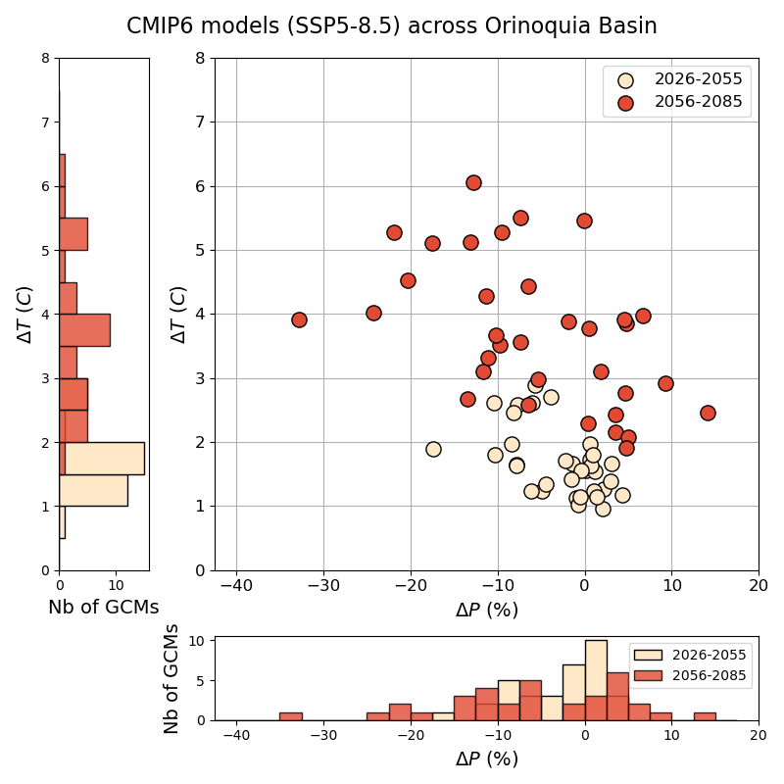
Climate projections CMIP6
SSP5 8.5
Historical period: 1985-2014 (30 years)
Two future periods
Near future: 2026-2055 (30 years)
Far future: 2056-2085 (30 years)

Slide 9
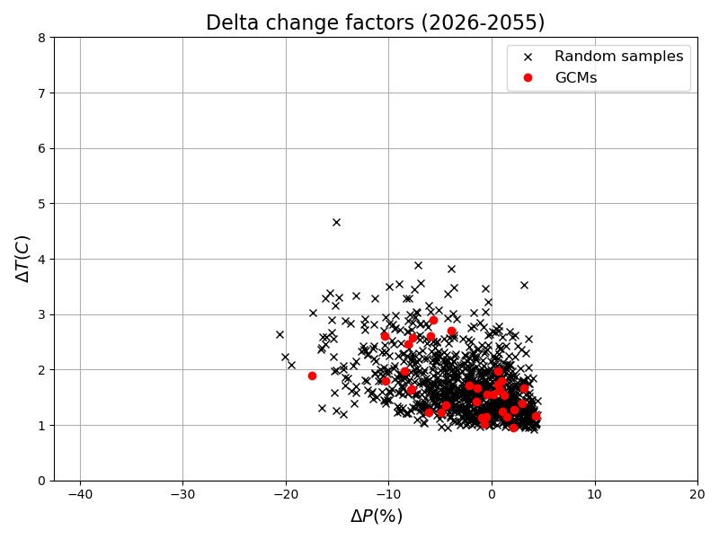
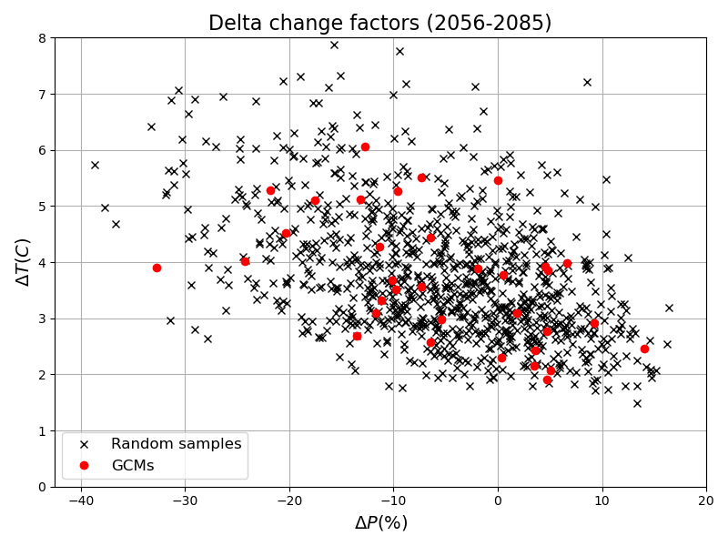
Random sampling from joint distributions Gaussian copula (marginals: Beta distributions for T, and Gamma distribution for P)
Random samples (x1000) will be used for establishing the distributions of the performance metrics merging the stress test and the information from CMIP6

Slide 10
Water demand scenarios and assumptions

Slide 11
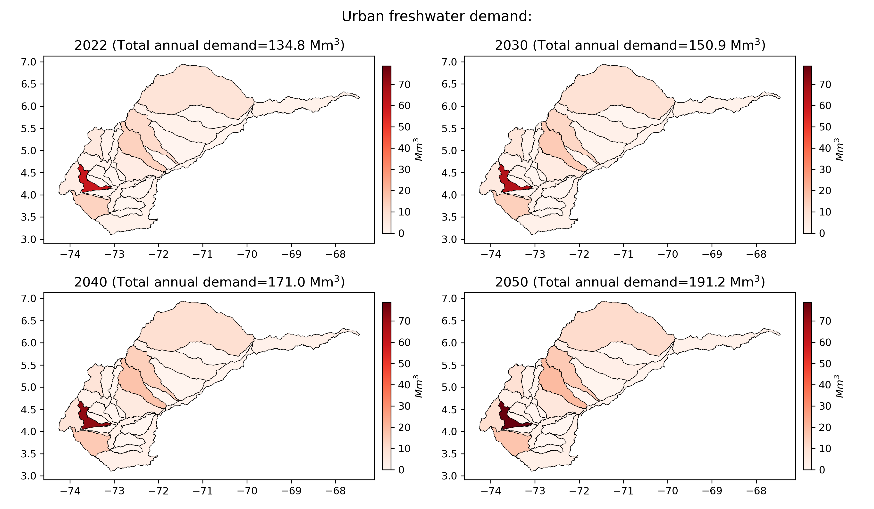
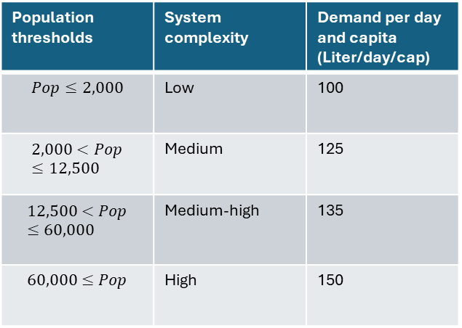
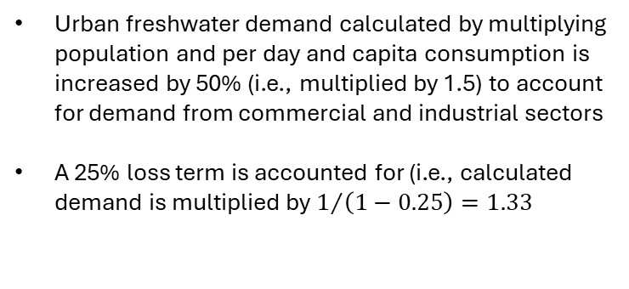
Urban Demand Scenarios and assumptions
Table 1: Water demand per day and habitant in urban areas
Population thresholds | System complexity | Demand per day and capita (Liter/day/cap)
$$Pop≤2,000$$ | Low | 100
$$2,000<Pop≤12,500$$ | Medium | 125
$$12,500<Pop≤60,000$$ | Medium-high | 135
$$60,000≤Pop$$ | High | 150
Urban freshwater demand calculated by multiplying population and per day and capita consumption is increased by 50% (i.e., multiplied by 1.5) to account for demand from commercial and industrial sectors
A 25% loss term is accounted for (i.e., calculated demand is multiplied by $1/{\left(1−0.25\right)=1.33}$
Source to support the assumption in Table 1:
https://www.minvivienda.gov.co/sites/default/files/documentos/titulo_d.pdf
https://comunidad.udistrital.edu.co/javalerof/files/2015/09/titulo_d_version_prueba.pdf

Slide 12
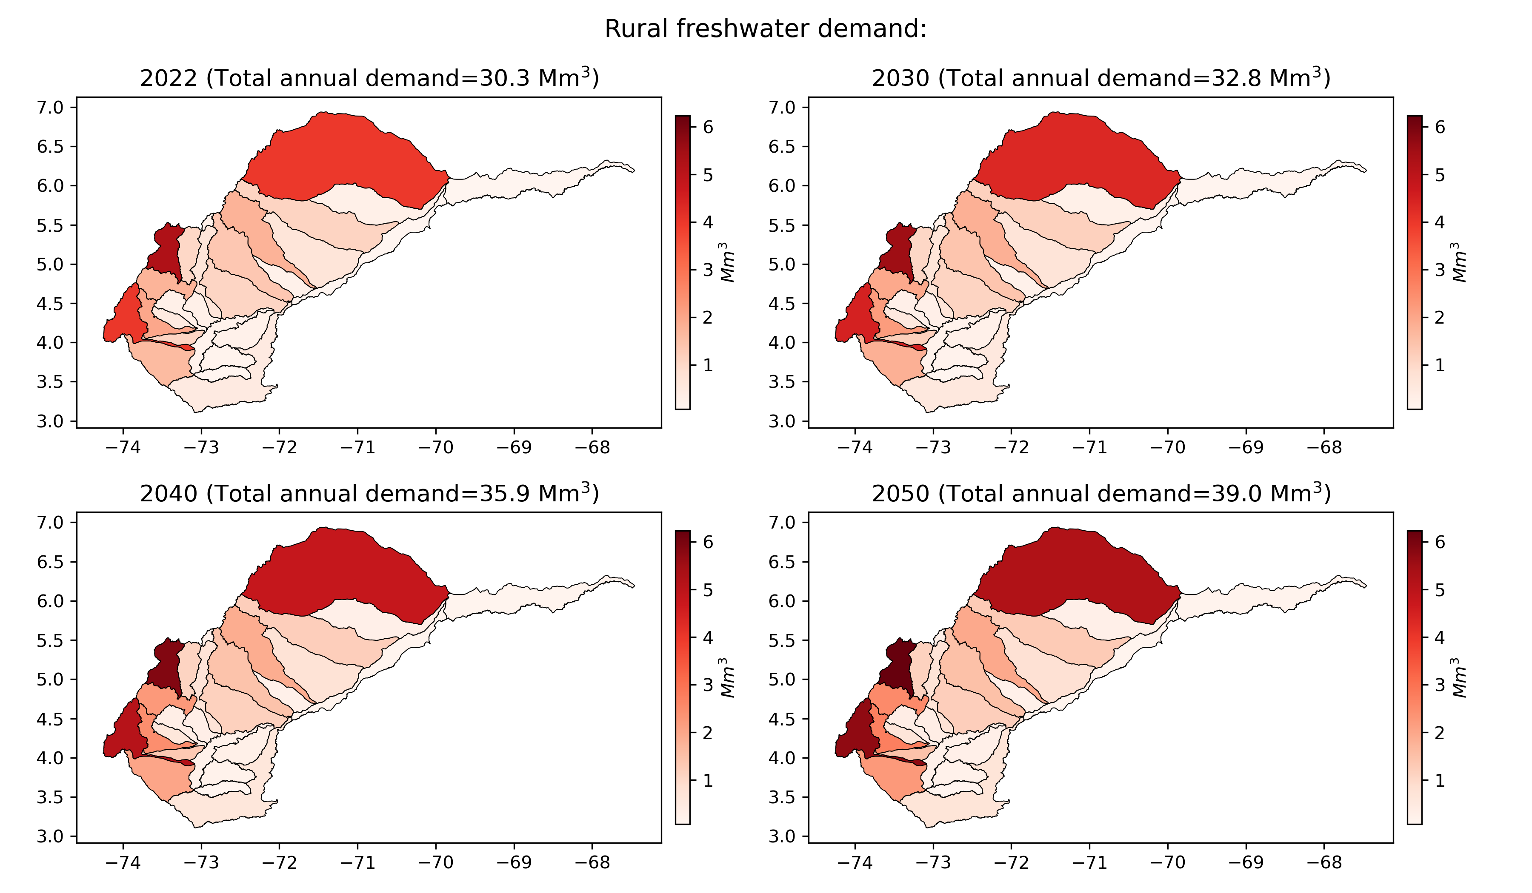
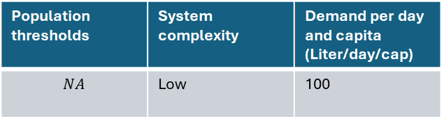
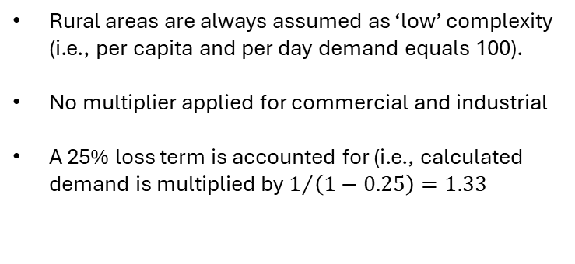
Rural Demand Scenarios and assumptions
Table 1: Water demand per day and habitant in rural areas
Population thresholds | System complexity | Demand per day and capita (Liter/day/cap)
$$NA$$ | Low | 100
Rural areas are always assumed as ‘low’ complexity (i.e., per capita and per day demand equals 100).
No multiplier applied for commercial and industrial
A 25% loss term is accounted for (i.e., calculated demand is multiplied by $1/{\left(1−0.25\right)=1.33}$
Source to support the assumption in Table 1:
https://www.minvivienda.gov.co/sites/default/files/documentos/titulo_d.pdf
https://comunidad.udistrital.edu.co/javalerof/files/2015/09/titulo_d_version_prueba.pdf

Slide 13
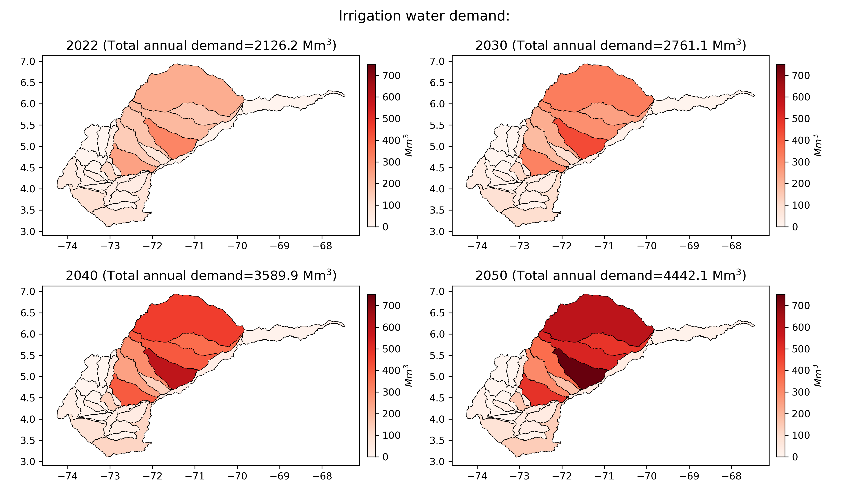
Irrigation Demand Scenarios and assumptions
Two crops are included: Rice and Oil palm trees
Across all sub-basins, the below assumptions are considered for Rice:
15% of the rice cultivated land is assumed to be planted during the ‘dry’ season. 100% of those land are assumed to be irrigated
85% of the rice cultivated land is assumed to be planted during the ‘wet’ season. None of those plantation are assumed to be irrigated
Irrigation efficiency: 36%
Across all sub-basins, the below assumptions are considered for Oil palm trees:
30% of the oil palm tree plantation are assumed to be irrigated
Irrigation efficiency: 36%
Note: irrigation demand shown on these maps does not include the effect of climate change. The projected years refer to the projections in cultivated areas only.

Slide 14
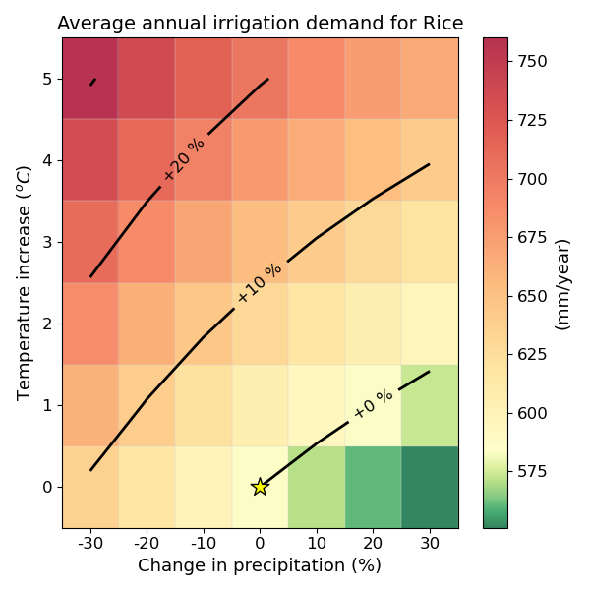
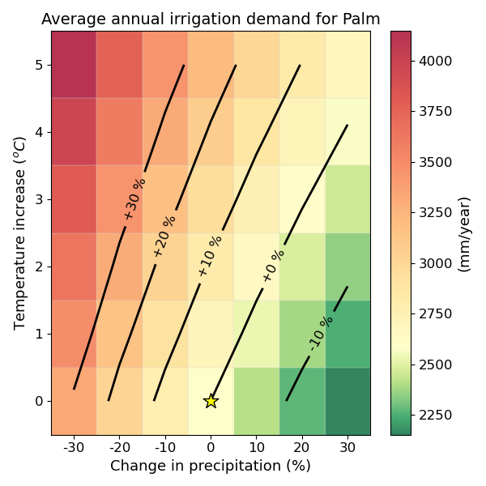
Irrigation requirement: sensitivity to climate change
Simulated irrigation requirement for Rice
Simulated irrigation requirement for oil palm trees
Note 1: the star symbols show the ‘no climate change’ scenario.
Note 2: the black lines are isolines of specific changes from the reference ‘no change scenario’.
Notes:
Name colorbar axis ‘irr requiremewnts’

Slide 15
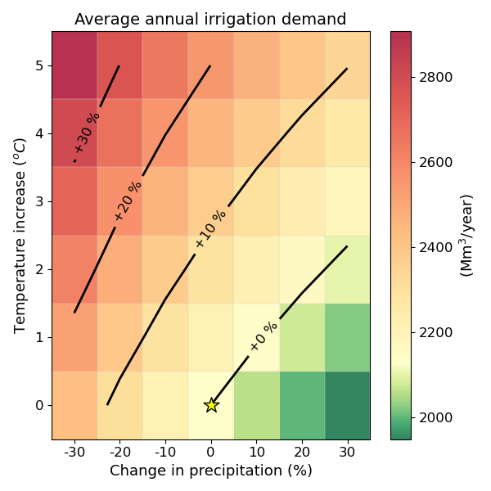

Total irrigation demand across the Orinoquia River basin
Irrigated areas as in 2022
Projected irrigated areas as in 2050

Slide 16
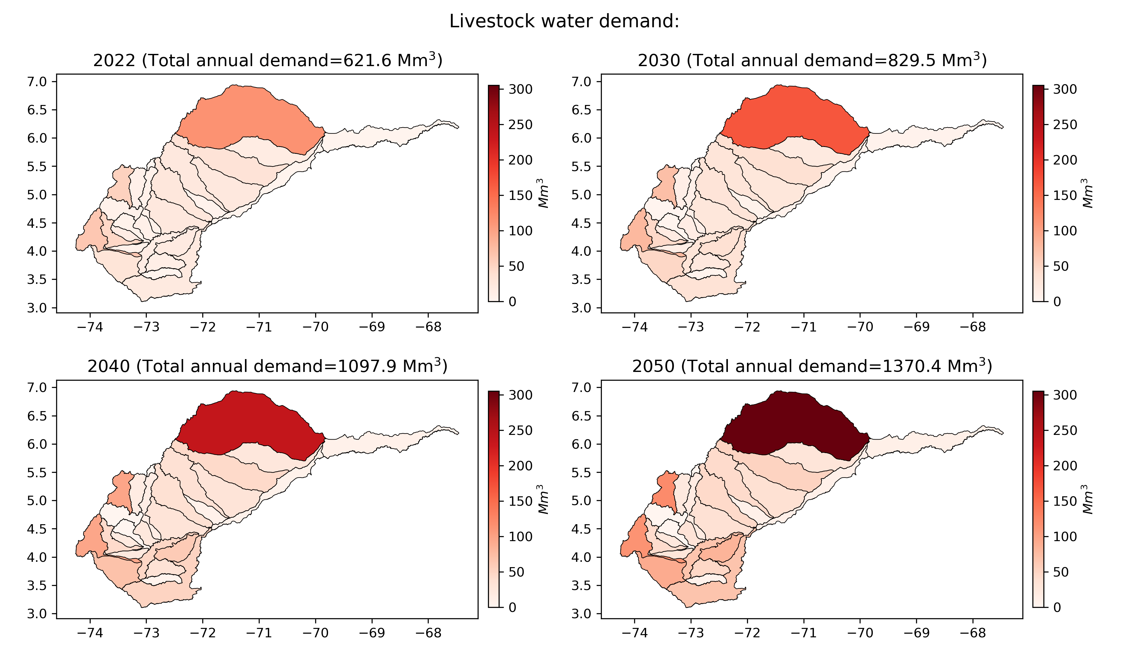
Livestock Demand Scenarios and assumptions
Three animal types are considered: chickens, pigs and cattle
The following assumptions are applied to all sub-basins:
Table 2: Water use per animal in livestock industries
 | Chickens | Pigs | Cattle
Water use per head (m³/year) | 7.3 | 87.4 | 60.2
A loss term equal to 25% is applied

Slide 17
Consumptive demand (Summary)
 | 2022 | 2030 | 2040 | 2050
Urban | 134.8 | 150.9 (+12%) | 171.0 (+27%) | 191.2 (+42%)
Rural | 30.3 | 32.8 (+8%) | 35.9 (+18%) | 39.0 (+29%)
Irrigation | 2,126.2 | 2,761.1 (+30%) | 3,589.9 (+69%) | 4,442.1 (+109%)
Livestock | 603.8 | 808.3 (+33%) | 1,072.5 (+78%) | 1,340.7 (+122%)
Total | 2,895.1 | 3,753.1 (+30%) | 4,869.3 (+68%) | 6,013.0 (+108%)
Note 1: Values are given in Mm³/year
Note 2 : Percent changes are calculated from the ‘2022’ baseline. Percent values are rounded to the closest integer.

Slide 18
River flow scenarios

Slide 19
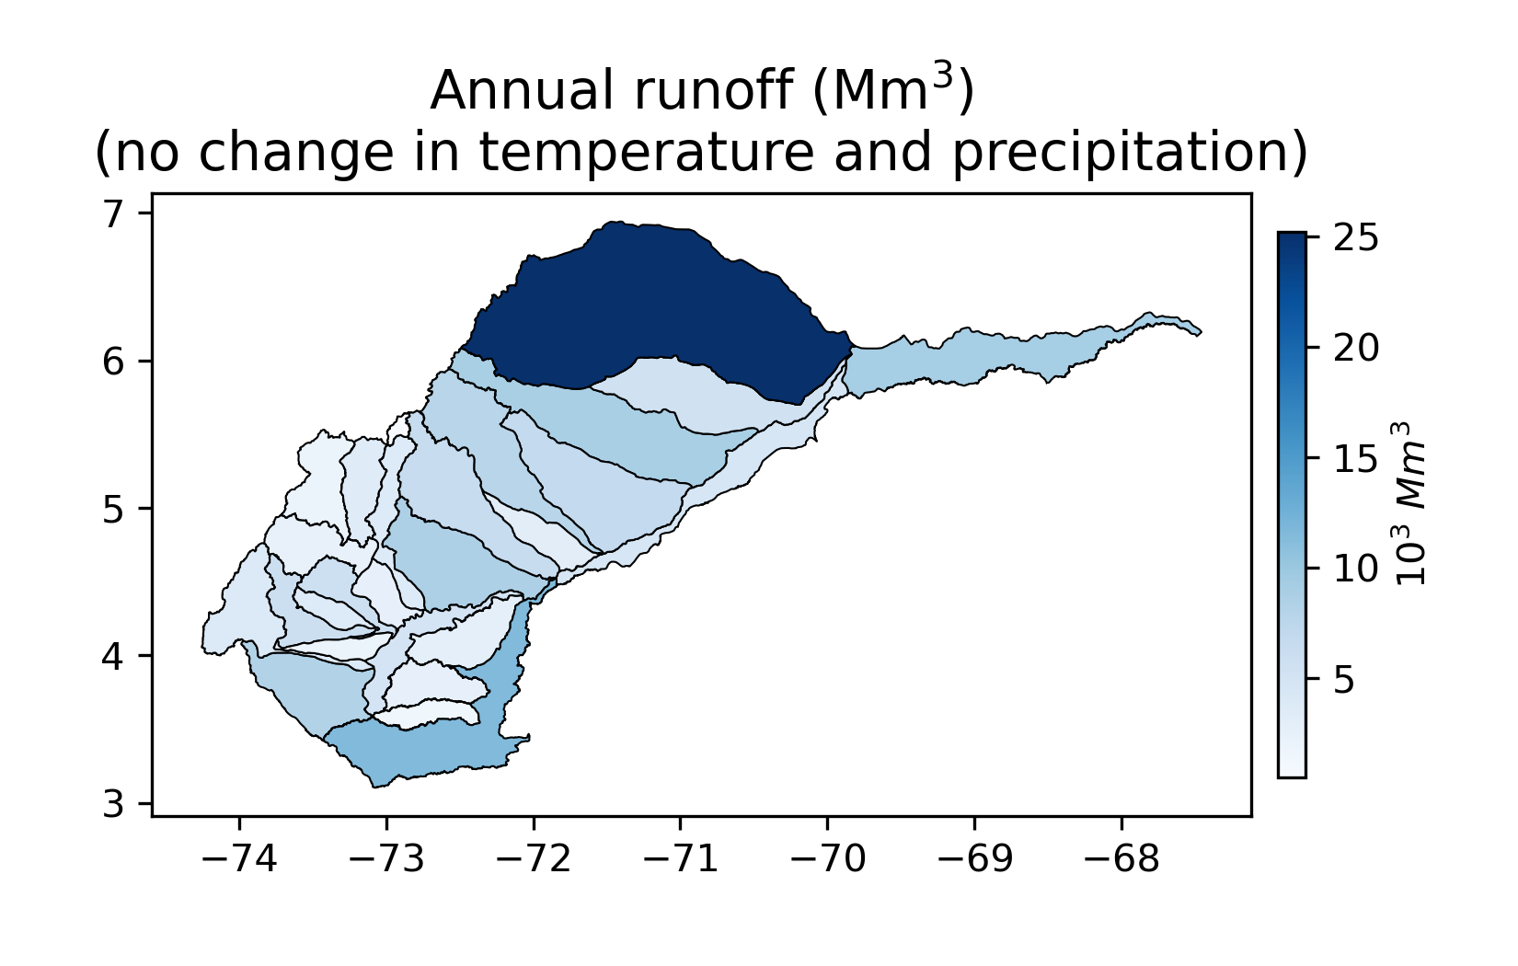
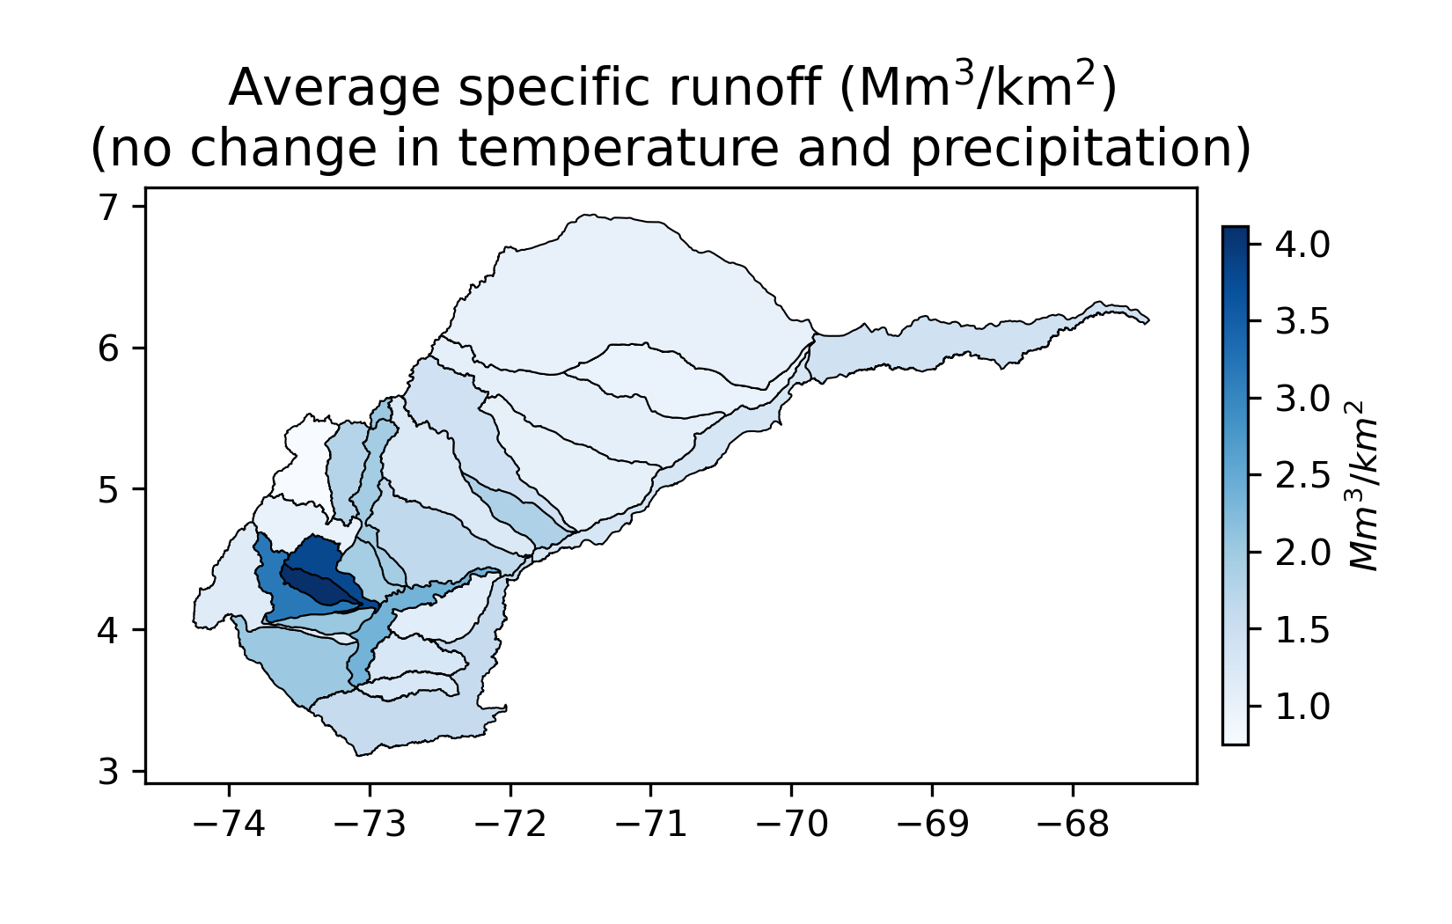
Streamflow spatial variability
The maps below illustrate the spatial variability of the runoff generation across the Orinoquia River basin. Results are averaged across 5 stochastic realizations. No climate change is assumed.
The map of average specific runoff shows that upstream areas located at higher elevations tends to produce more runoff than lowlands.
Note: Annual runoff depends on the sub-basin area
Note: Specific runoff highlights sub-basins that generate more runoff per km²

Slide 20
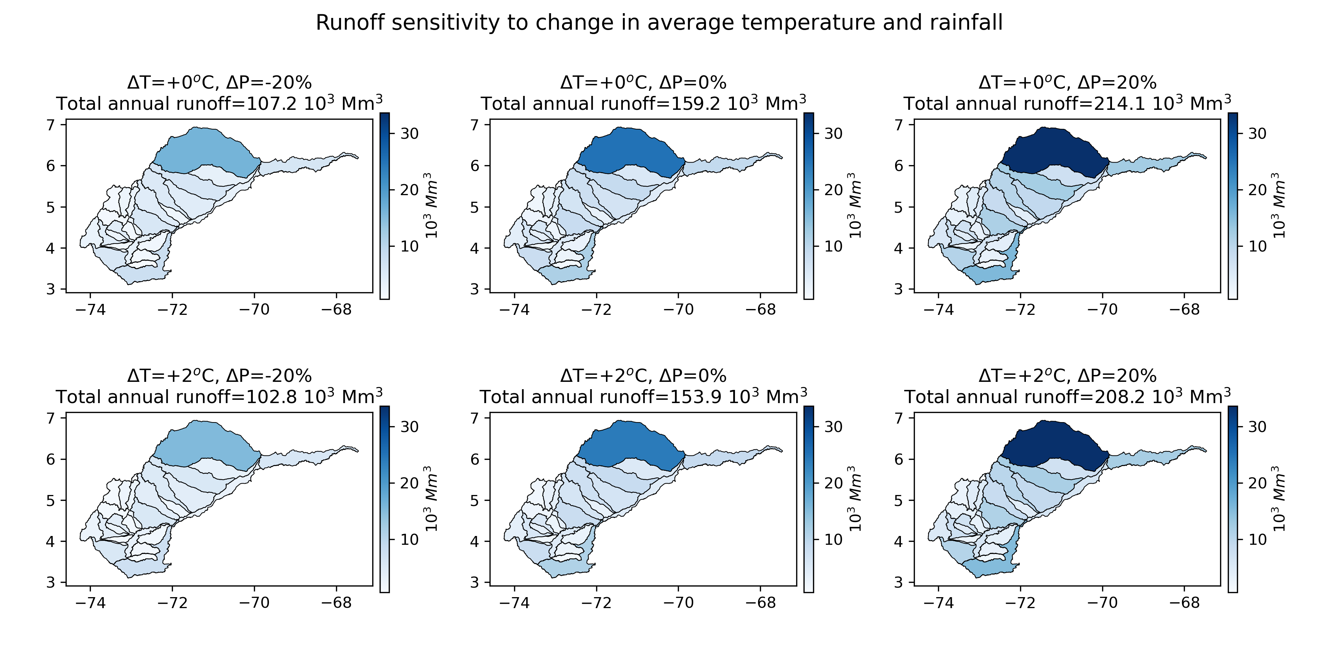
Streamflow: sensitivity to rainfall and temp changes

Slide 21
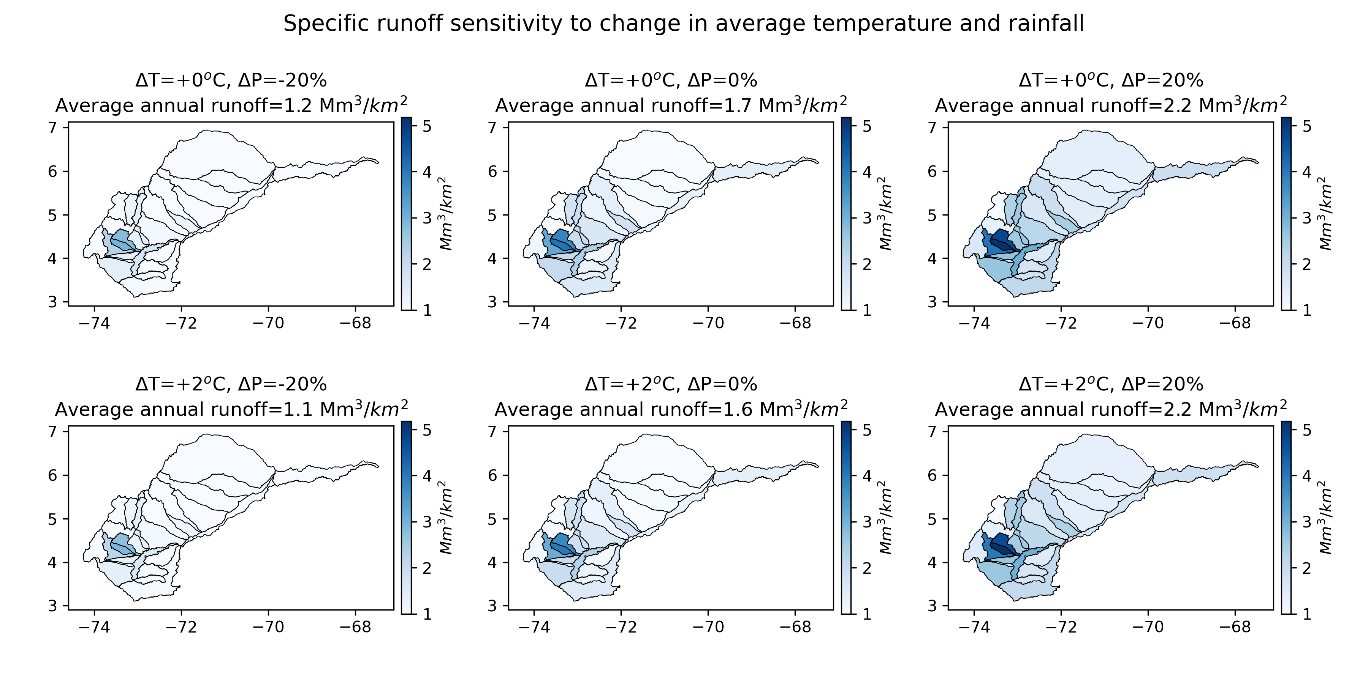
Streamflow: sensitivity to rainfall and temp changes

Slide 22
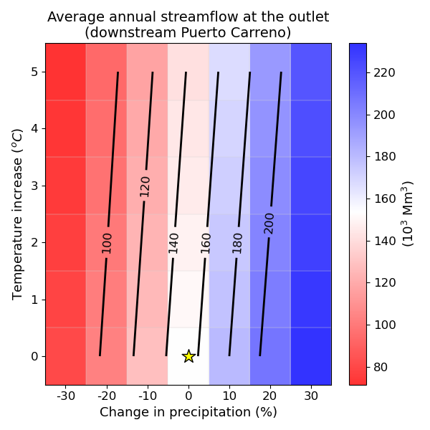
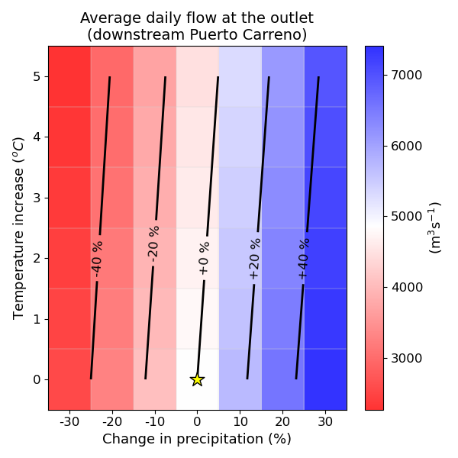
Streamflow: sensitivity to rainfall and temp changes
The effect of temperature change is negligeable when compared to the effect of change in rainfall

Slide 23
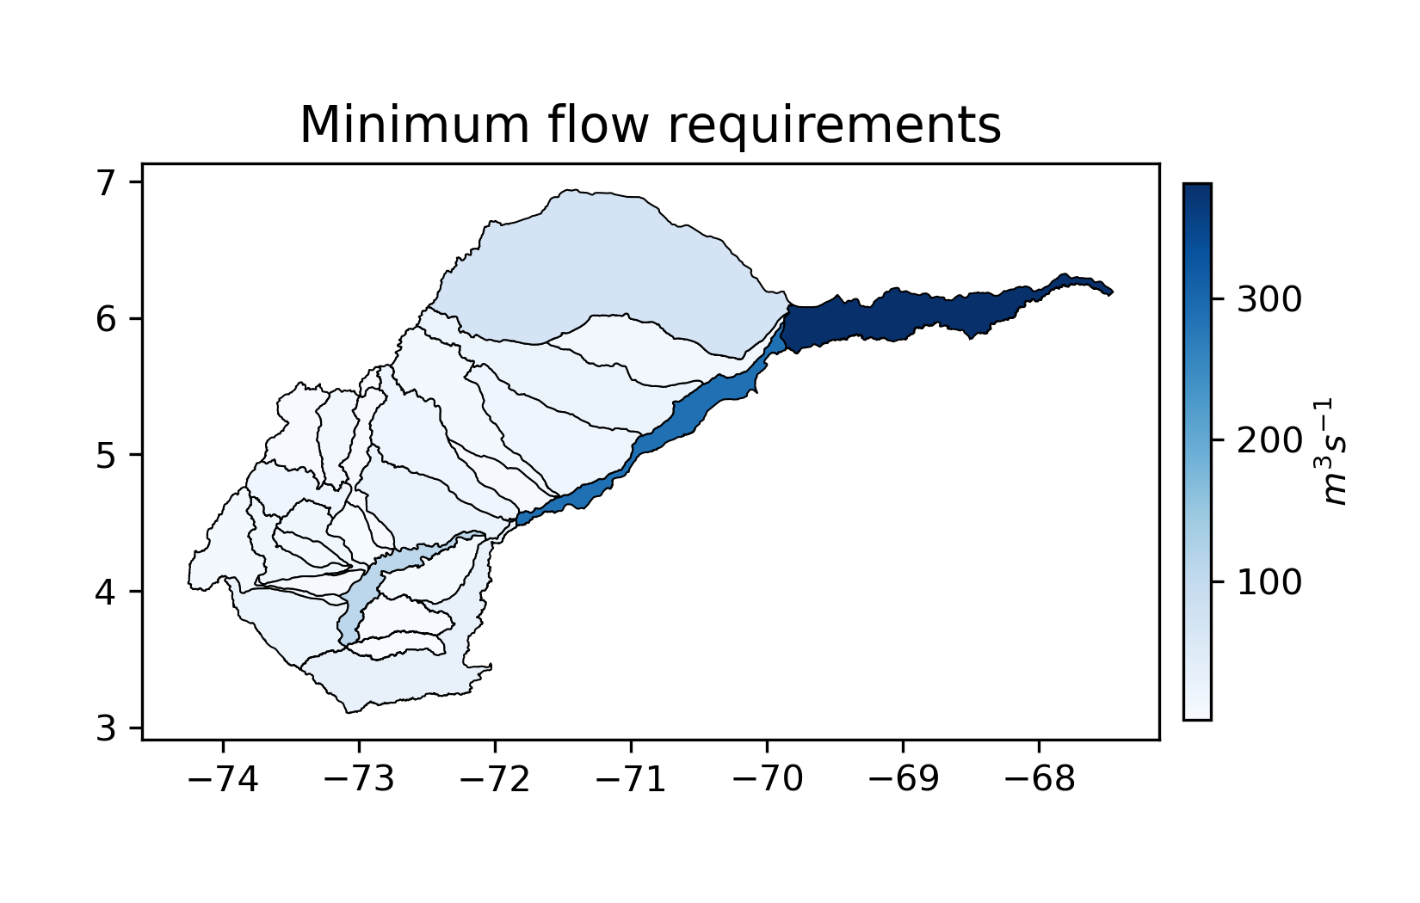
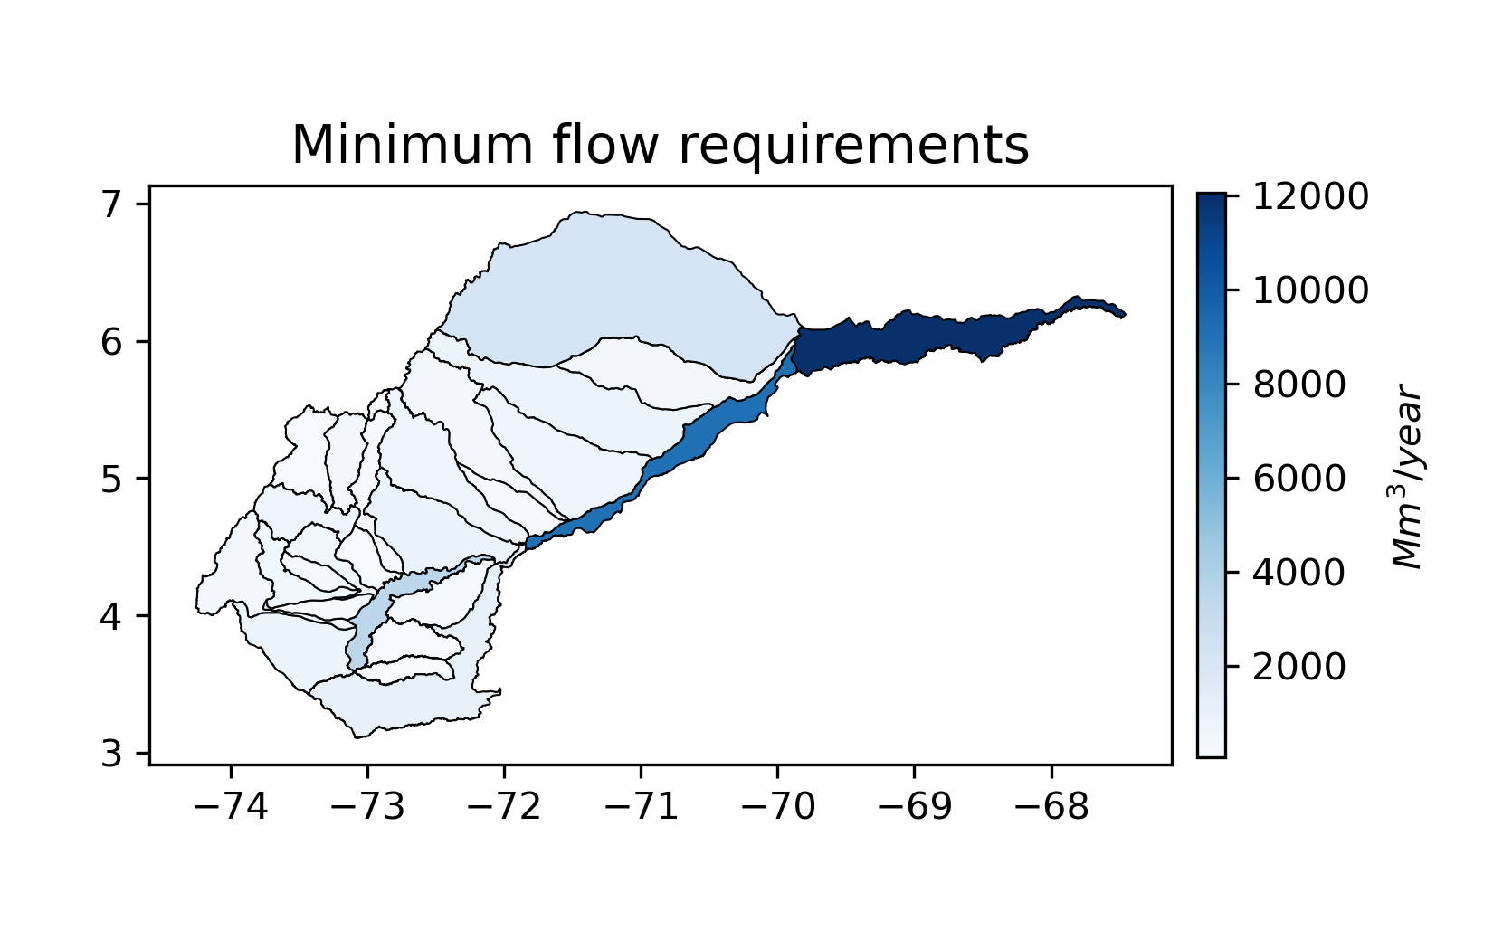
Environmental flow constraints
Minimum flow requirements are equal to 25% of the average dry season flow (December through March).
Note: The two maps shows the same variable – the unit is different.

Slide 24
Preliminary results
Visualization of deliveries and demand time series
Variability in space
Climate response function to assess vulnerability

Slide 25
Time series: Effect of climate change

Slide 26
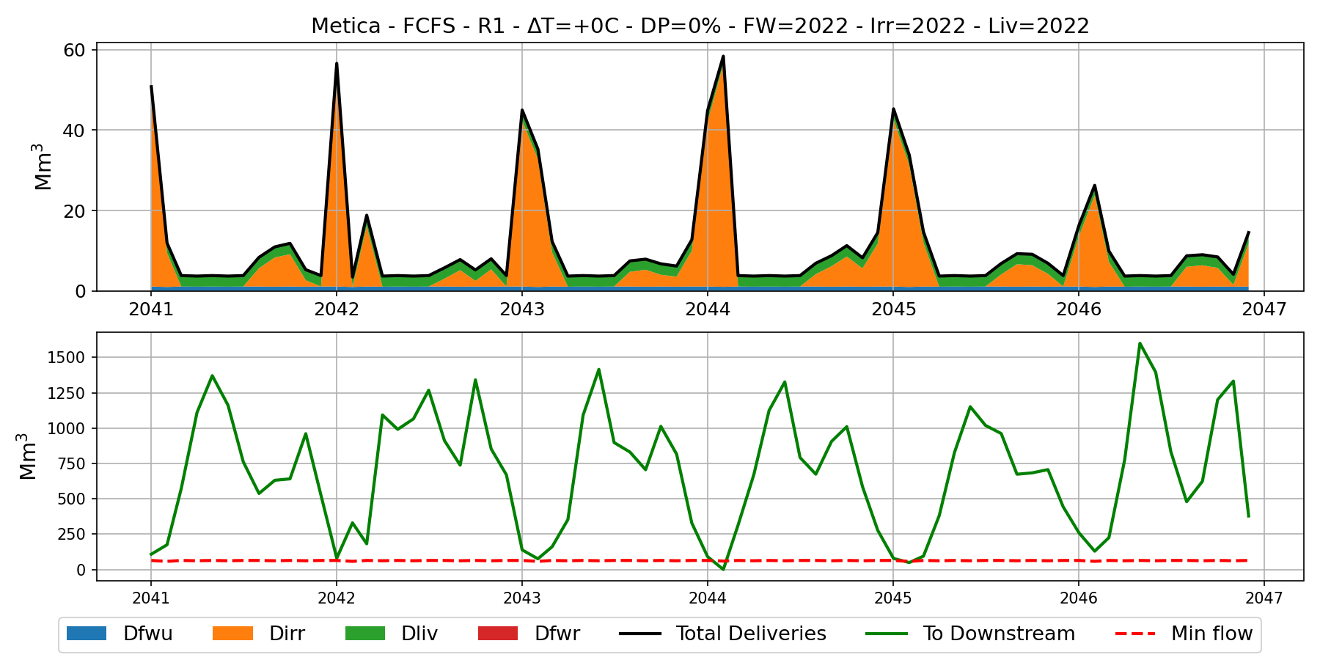
Example : Metica sub-basin – FCFS policy – No Climate change - Demand as in 2022
No deficit: black line (deliveries) on top of demand (colors)
Minimum flow requirement is not satisfied during these months
Top plot: Dfwu: urban freshwater demand; Dirr: irrigation demand; Dliv: demand for livestock; Dfwr: rural freshwater demand
Bottom plot: To downstream: water volume that flows to the downstream basin; Min flow: minimum flow requirement

Slide 27
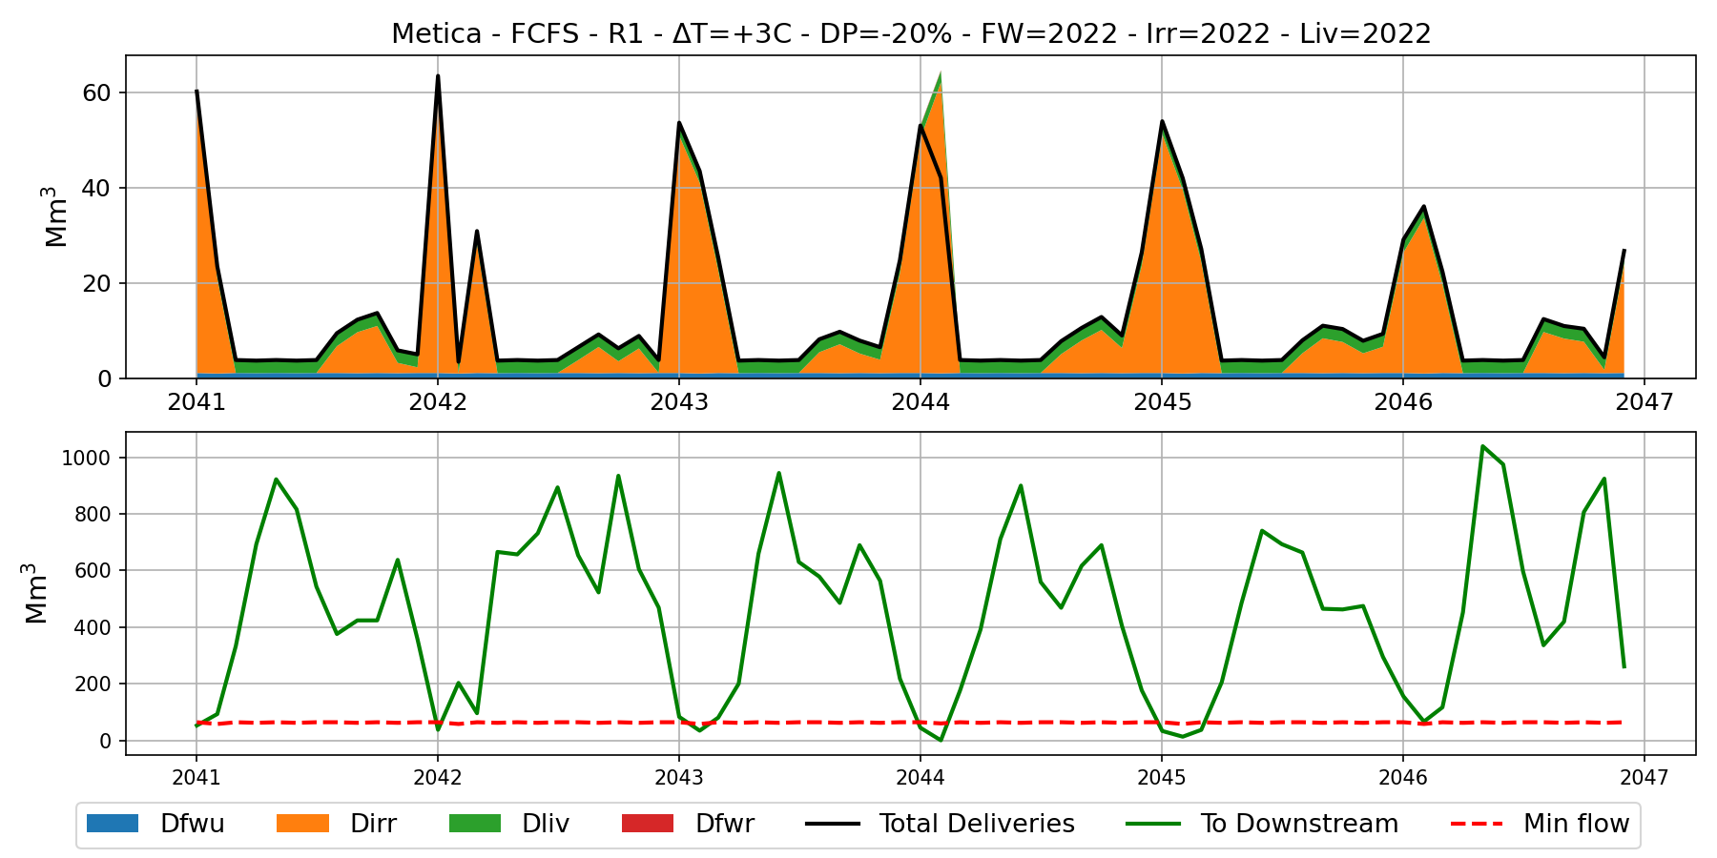
Example : Metica sub-basin – FCFS policy – +3ºC; -20% rainfall- Demand as in 2022
Climate change may lead to significant deficit in deliveries during some years
Deficits in minimum flow requirements are more frequent
Top plot: Dfwu: urban freshwater demand; Dirr: irrigation demand; Dliv: demand for livestock; Dfwr: rural freshwater demand
Bottom plot: To downstream: water volume that flows to the downstream basin; Min flow: minimum flow requirement

Slide 28
Time series: Effect of demand change

Slide 29
Example : Metica sub-basin – FCFS policy – No Climate change - Demand as in 2022
Top plot: Dfwu: urban freshwater demand; Dirr: irrigation demand; Dliv: demand for livestock; Dfwr: rural freshwater demand
Bottom plot: To downstream: water volume that flows to the downstream basin; Min flow: minimum flow requirement

Slide 30
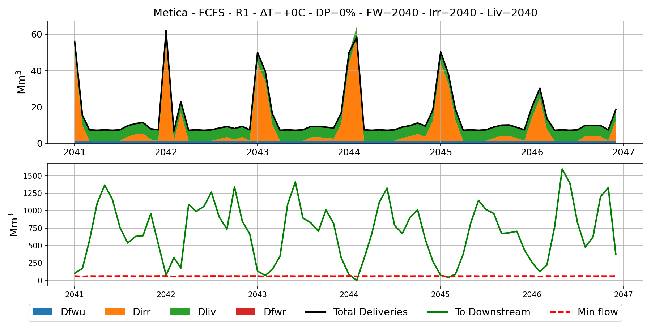
Example : Metica sub-basin – FCFS policy – No Climate change - Demand as in 2040
Demand change may lead to an increase in deficit during some years
Top plot: Dfwu: urban freshwater demand; Dirr: irrigation demand; Dliv: demand for livestock; Dfwr: rural freshwater demand
Bottom plot: To downstream: water volume that flows to the downstream basin; Min flow: minimum flow requirement

Slide 31
Time series: Effect of different “policies” (order to which the users are served)

Slide 32
Example : Metica sub-basin – FCFS policy – No Climate change - Demand as in 2022
Top plot: Dfwu: urban freshwater demand; Dirr: irrigation demand; Dliv: demand for livestock; Dfwr: rural freshwater demand
Bottom plot: To downstream: water volume that flows to the downstream basin; Min flow: minimum flow requirement

Slide 33
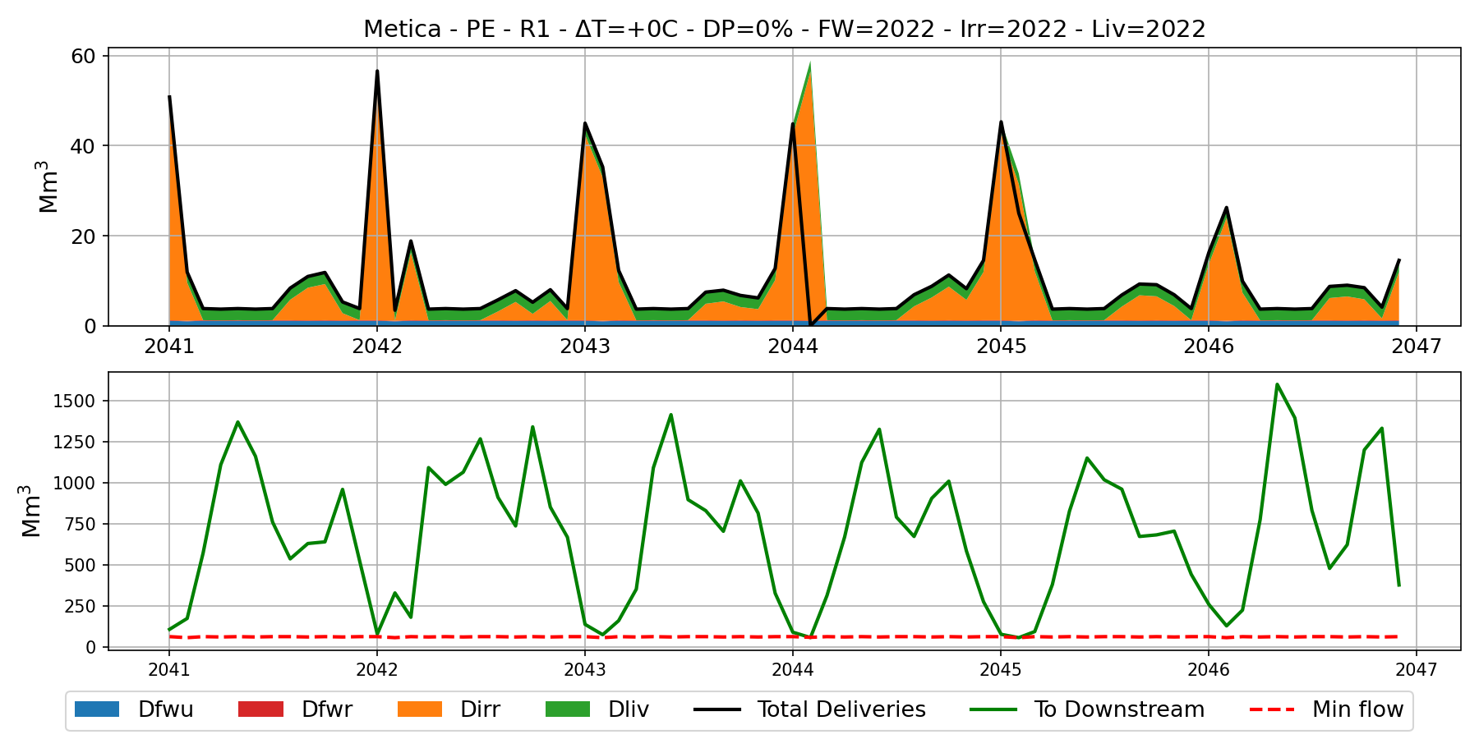
Example : Metica sub-basin – PE policy – No Climate change - Demand as in 2022
Enforcing the minimum flow leads to deficit in water deliveries
Top plot: Dfwu: urban freshwater demand; Dirr: irrigation demand; Dliv: demand for livestock; Dfwr: rural freshwater demand
Bottom plot: To downstream: water volume that flows to the downstream basin; Min flow: minimum flow requirement

Slide 34
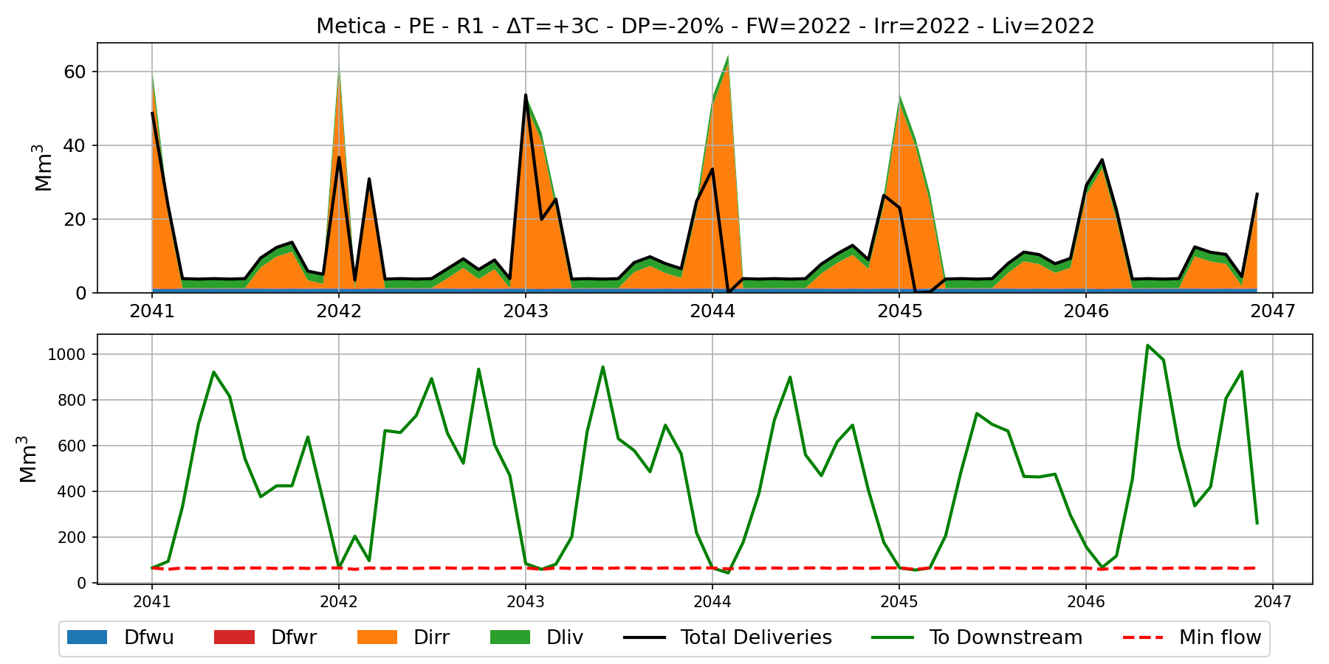
Example : Metica sub-basin – PE policy – +3ºC; -20% rainfall- Demand as in 2022
With climate change, enforcing the minimum flow is no longer enough to guarantee this objective
Top plot: Dfwu: urban freshwater demand; Dirr: irrigation demand; Dliv: demand for livestock; Dfwr: rural freshwater demand
Bottom plot: To downstream: water volume that flows to the downstream basin; Min flow: minimum flow requirement

Slide 35
Variability in space – climate change and policies

Slide 36
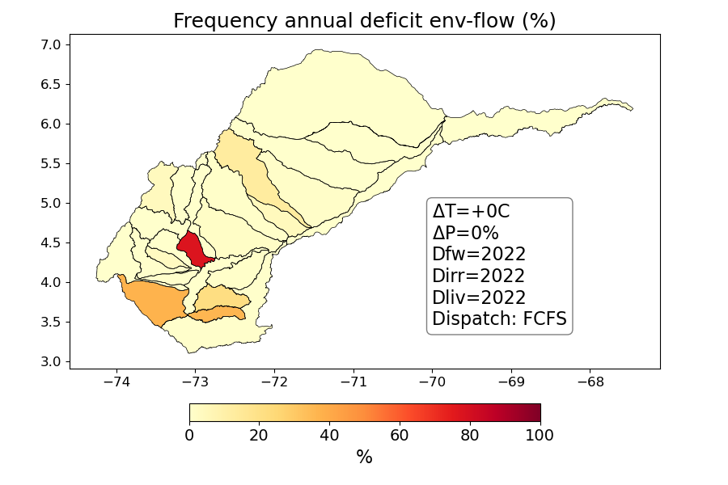
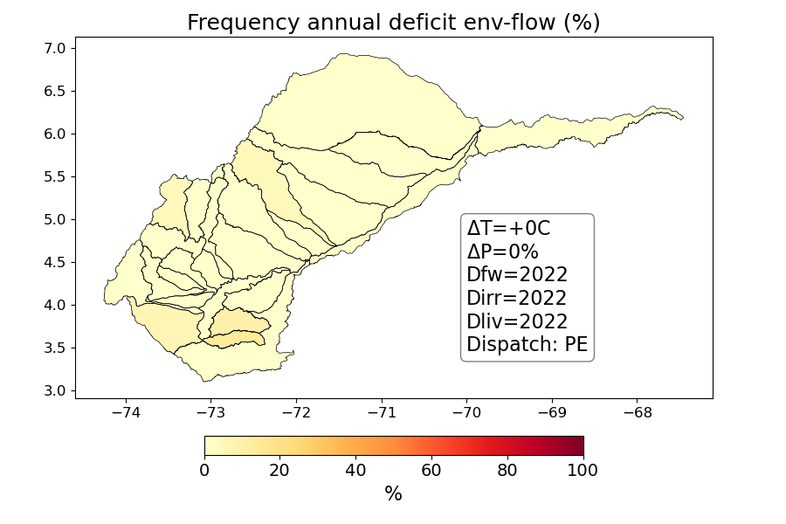
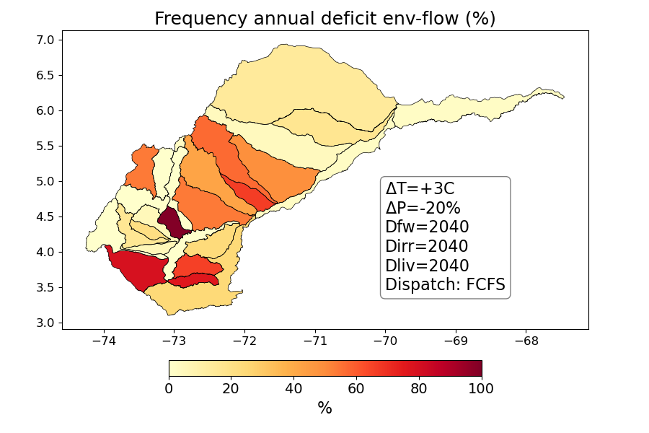
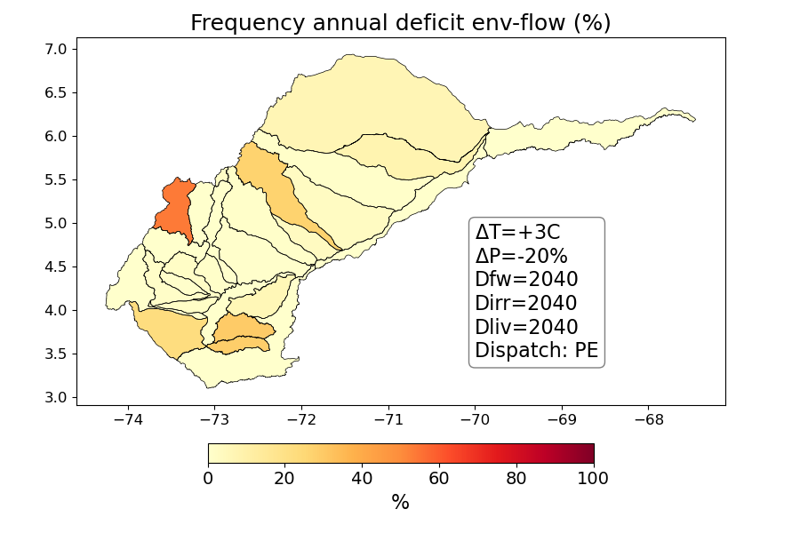
Frequency of annual deficit in minimum flow
Policy FCFS
Policy PE
No climate change Demand as in 2022
+3ºC
-20% rainfall
Demand as in 2040

Slide 37
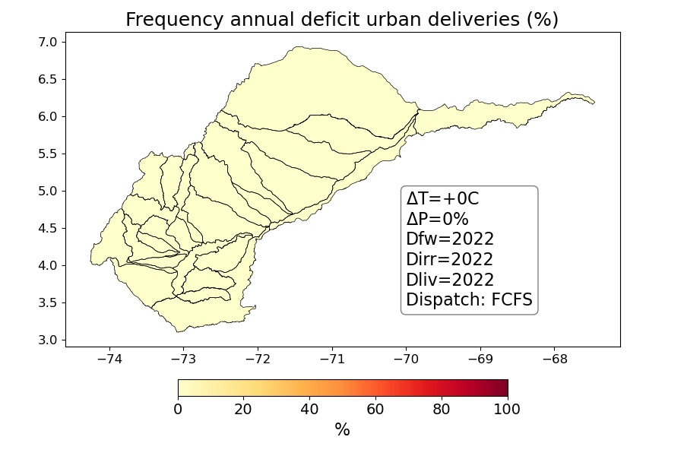
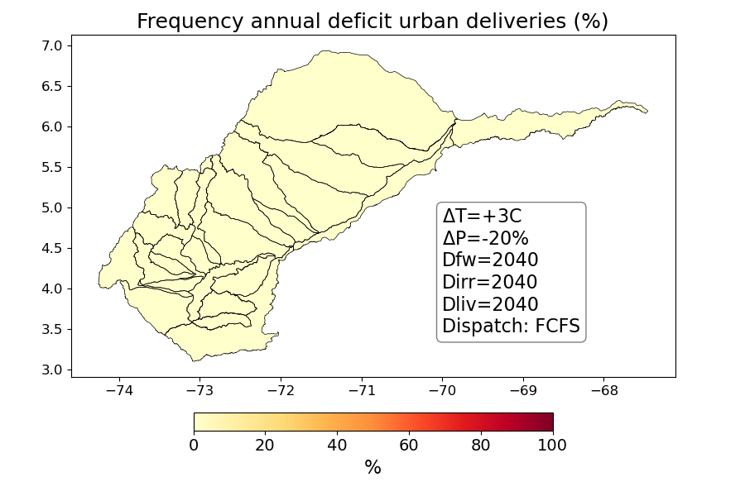
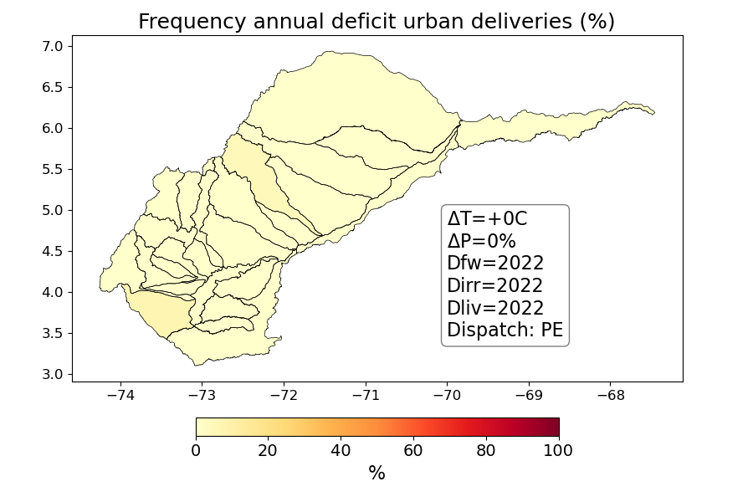
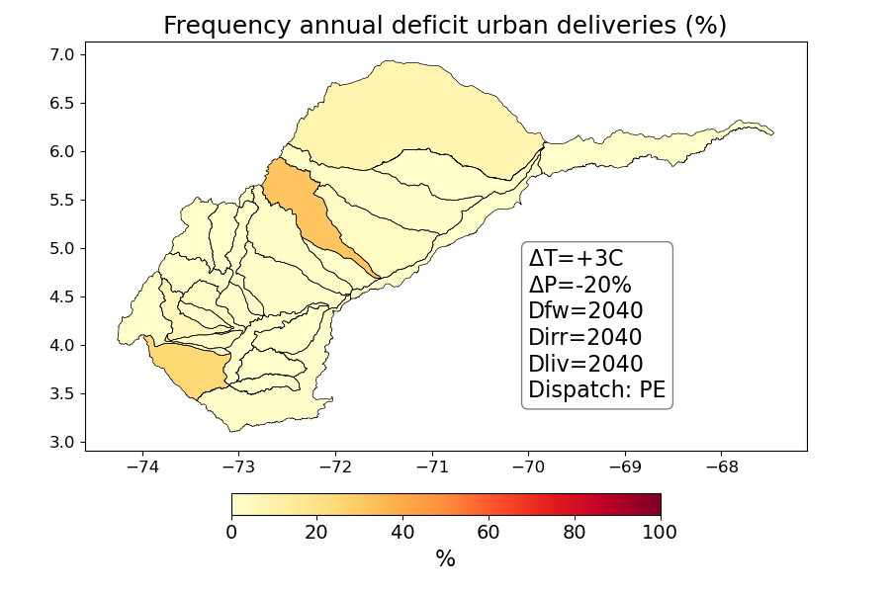
Frequency of annual deficit in urban deliveries
Policy FCFS
Policy PE
No climate change Demand as in 2022
+3ºC
-20% rainfall
Demand as in 2040

Slide 38
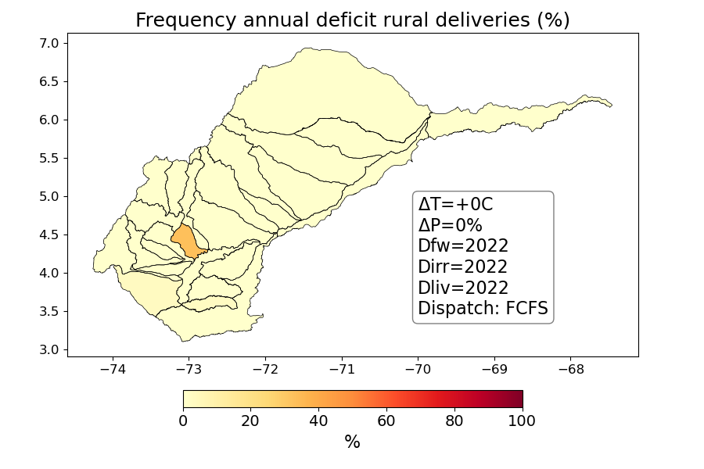
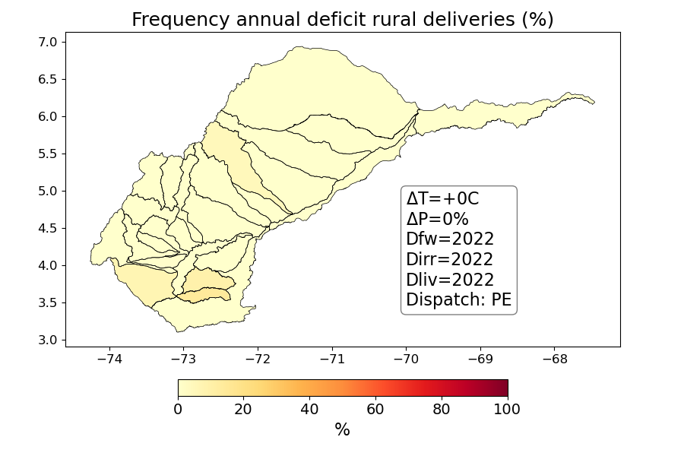
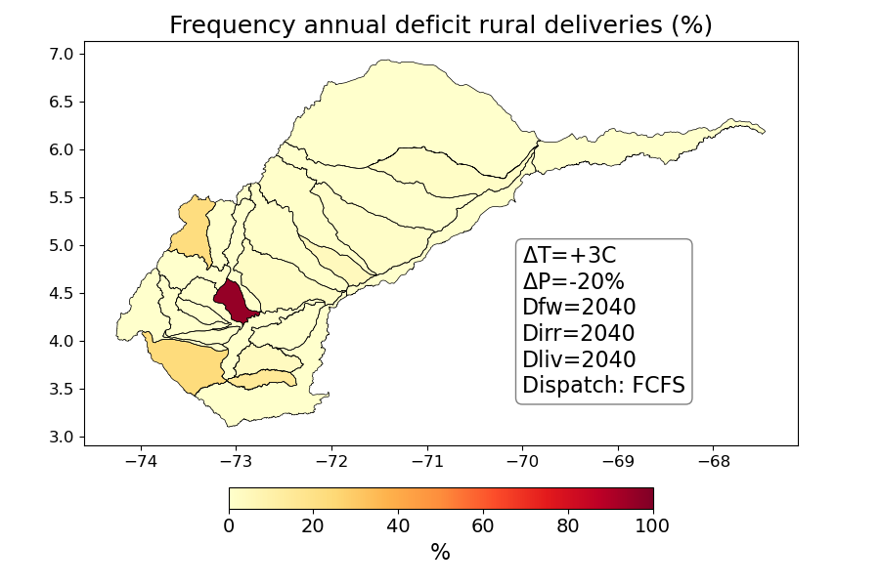
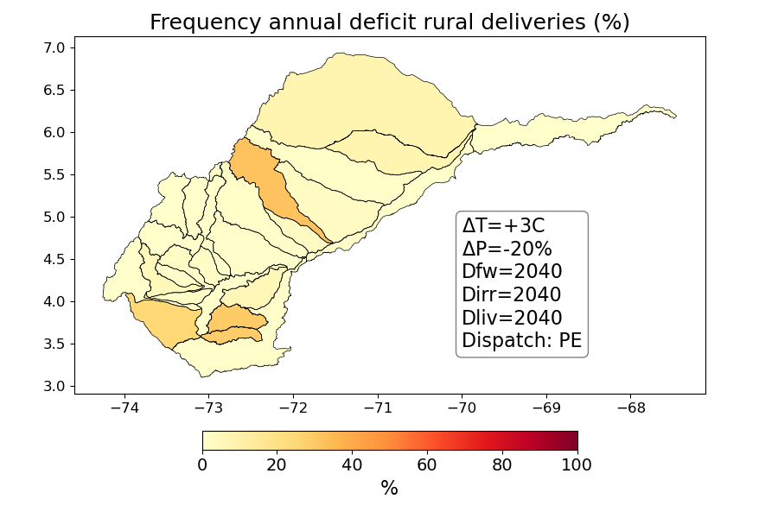
Frequency of annual deficit in rural deliveries
Policy FCFS
Policy PE
No climate change Demand as in 2022
+3ºC
-20% rainfall
Demand as in 2040

Slide 39
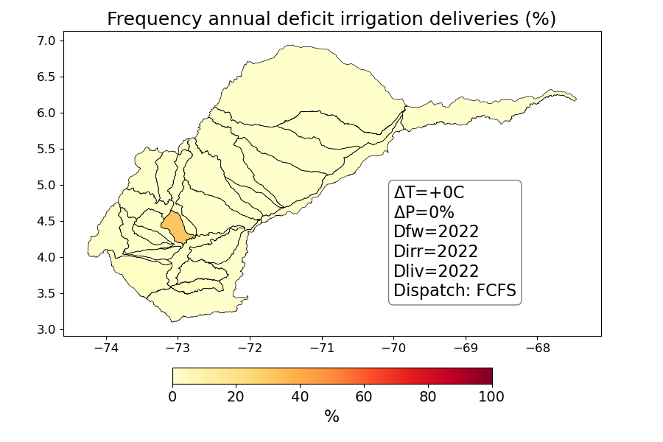
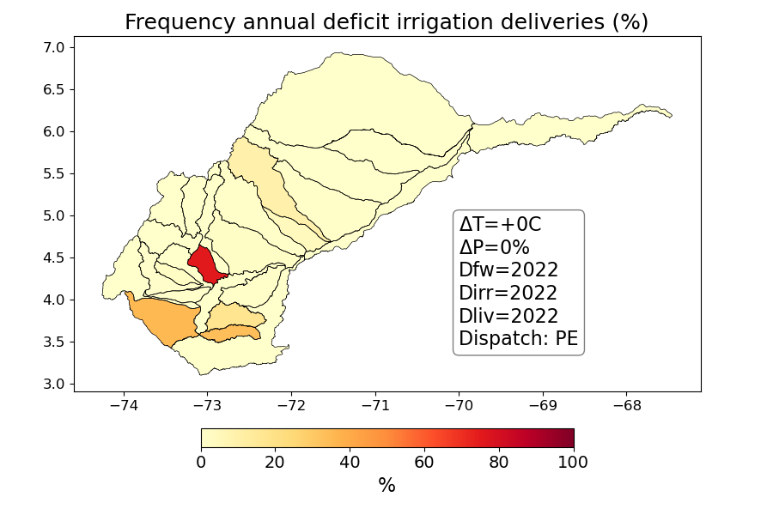

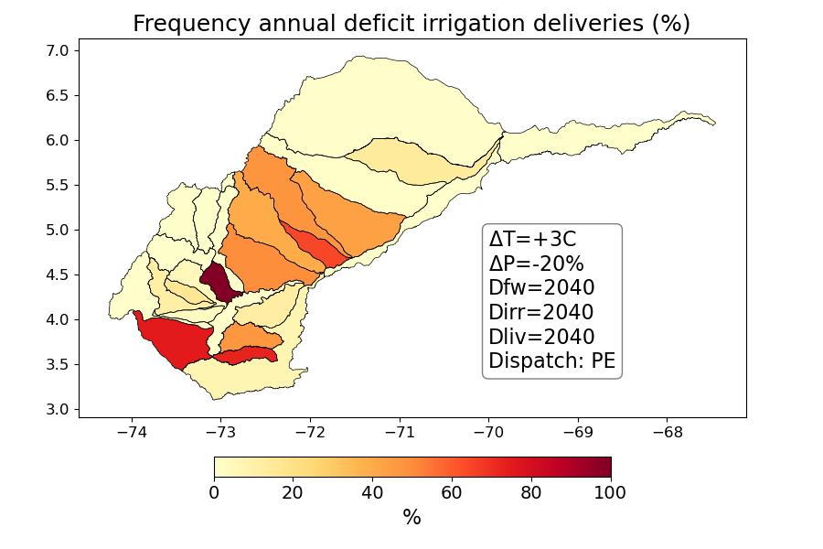
Frequency of annual deficit in irrigation deliveries
Policy FCFS
Policy PE
No climate change Demand as in 2022
+3ºC
-20% rainfall
Demand as in 2040

Slide 40

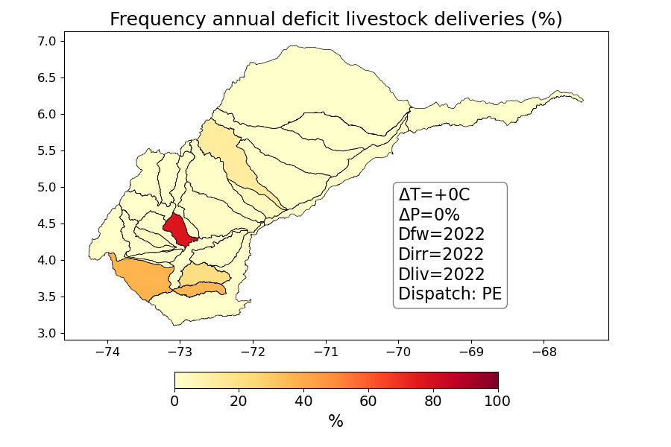


Frequency of annual deficit in livestock deliveries
Policy FCFS
Policy PE
No climate change Demand as in 2022
+3ºC
-20% rainfall
Demand as in 2040

Slide 41
Climate response function to assess vulnerability

Slide 42
Illustration with Metica sub-basin

Slide 43
Freshwater urban deliveries

Slide 44
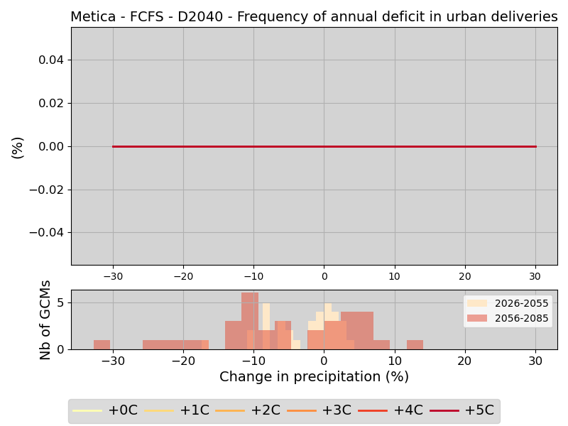
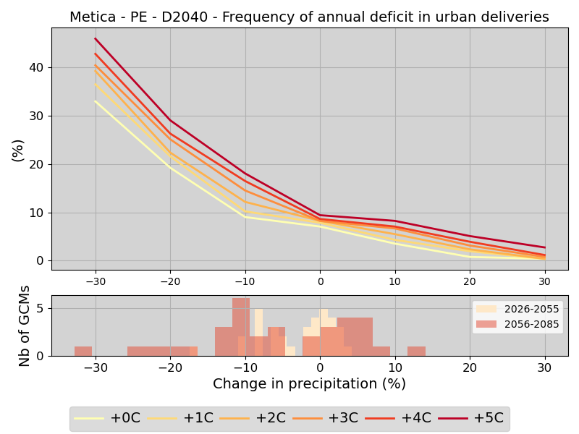
Effect of precipitation change (x-axis) and temperature change (colors) on the frequency of annual in urban freshwater deficit.
Demand as in 2040
Policy FCFS
Policy PE

Slide 45
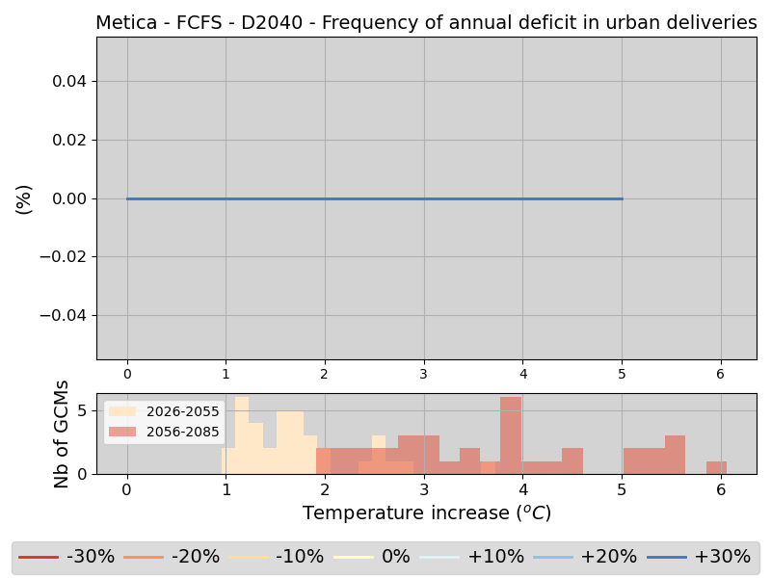
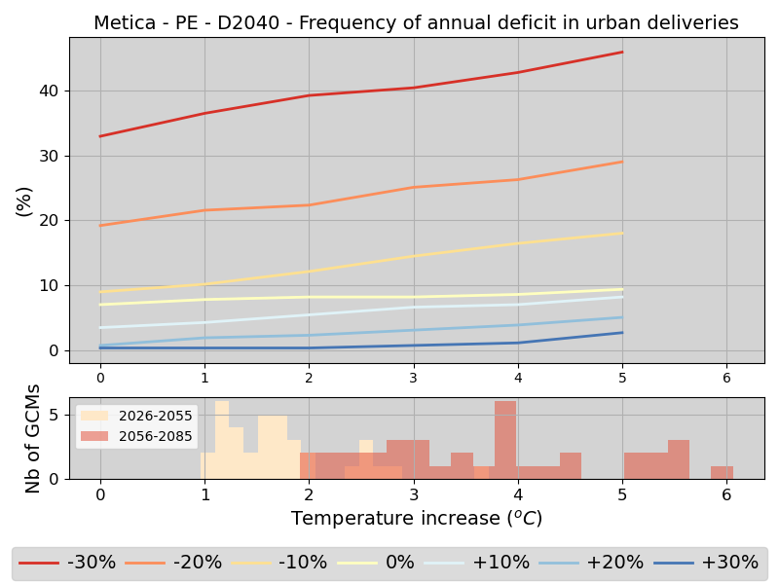
Effect of precipitation change (colors) and temperature change (x-axis) on the frequency of annual in urban freshwater deficit.
Demand as in 2040
Policy FCFS
Policy PE

Slide 46
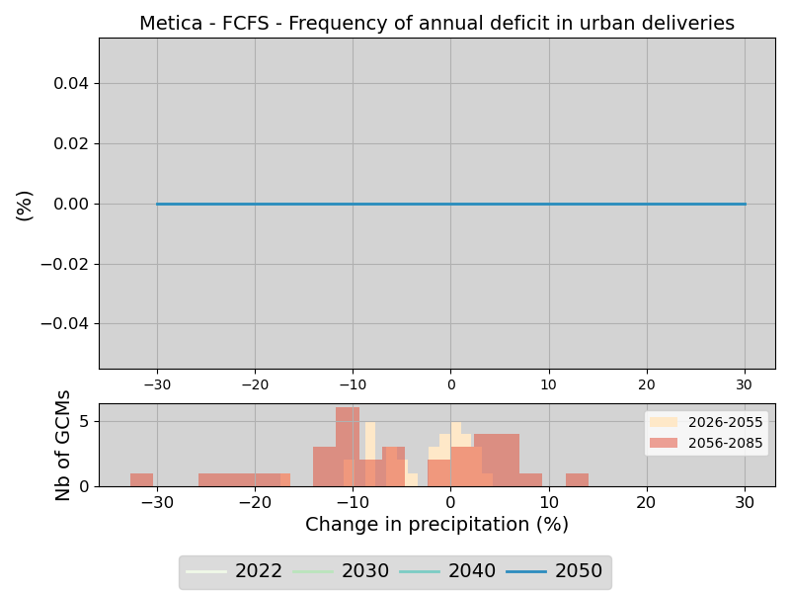
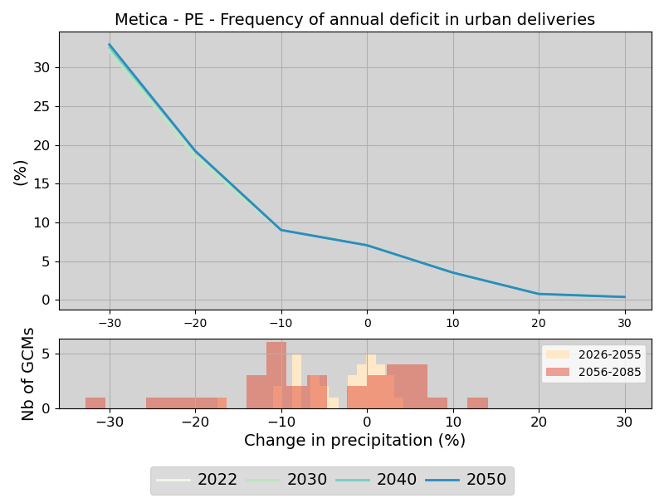
Effect of precipitation change (x-axis) and demand change (colors) on the frequency of annual deficit in urban freshwater deliveries.
No temperature change
Policy FCFS
Policy PE

Slide 47


Effect of climate and policy change (Metica)
Urban demand – Demand as in 2040
Warning: color bars are different for the two scenarios

Slide 48
Irrigation water supply

Slide 49


Effect of precipitation change (x-axis) and temperature change (colors) on the frequency of annual deficit in irrigation deliveries.
Demand as in 2040
Policy FCFS
Policy PE

Slide 50


Effect of precipitation change (colors) and temperature change (x-axis) on the frequency of annual deficit in irrigation deliveries.
Demand as in 2040
Policy FCFS
Policy PE

Slide 51


Effect of precipitation change (x-axis) and temperature change (colors) on the frequency of annual deficit in irrigation deliveries.
No change in temperature
Policy FCFS
Policy PE

Slide 52


Effect of climate and policy change (Metica)
Agricultural demand – Demand as in 2040
Warning: color bars are different for the two scenarios

Slide 53
Livestock water deliveries

Slide 54


Effect of precipitation change (x-axis) and temperature change (colors) on the frequency of annual deficit in livestock water deliveries.
Demand as in 2040
Policy FCFS
Policy PE

Slide 55


Effect of precipitation change (colors) and temperature change (x-axis) on the frequency of annual deficit in livestock water deliveries.
Demand as in 2040
Policy FCFS
Policy PE

Slide 56


Effect of precipitation change (x-axis) and temperature change (colors) on the frequency of annual deficit in livestock water deliveries.
No change in temperature
Policy FCFS
Policy PE

Slide 57

Effect of climate and policy change (Metica)
Livestock demand – Demand as in 2040
Warning: color bars are different for the two scenarios

Slide 58
Rural freshwater deliveries

Slide 59


Effect of precipitation change (x-axis) and temperature change (colors) on the frequency of annual deficit in rural freshwater deliveries.
Demand as in 2040
Policy FCFS
Policy PE

Slide 60


Effect of precipitation change (colors) and temperature change (x-axis) on the frequency of annual deficit in rural freshwater deliveries.
Demand as in 2040
Policy FCFS
Policy PE

Slide 61


Effect of precipitation change (x-axis) and temperature change (colors) on the frequency of annual deficit in rural freshwater deliveries.
No change in temperature
Policy FCFS
Policy PE

Slide 62


Effect of climate and policy change (Metica)
Rural demand – Demand as in 2040
Warning: color bars are different for the two scenarios

Slide 63
Minimum flow requirements

Slide 64


Effect of precipitation change (x-axis) and temperature change (colors) on the frequency of annual deficit in minimum flow requirement deliveries.
Demand as in 2040
Policy FCFS
Policy PE

Slide 65


Effect of precipitation change (colors) and temperature change (x-axis) on the frequency of annual deficit in minimum flow requirement deliveries.
Demand as in 2040
Policy FCFS
Policy PE

Slide 66


Effect of precipitation change (x-axis) and temperature change (colors) on the frequency of annual deficit in minimum flow requirement deliveries.
No change in temperature
Policy FCFS
Policy PE

Slide 67


Effect of climate and policy change (Metica)
Environmental flow – Demand as in 2040
Warning: color bars are different for the two scenarios

Slide 68

Visualizing trade-offs among water users
Parallel coordinates plot: a useful tool for visualizing high-dimension dataset
Scenarios / assumptions
Performance metrics

Slide 69
Visualizing trade-offs among water users
Parallel coordinates plot: a useful tool for visualizing high-dimension dataset
Change in temperature
Scenarios / assumptions
Performance metrics

Slide 70
Visualizing trade-offs among water users
Parallel coordinates plot: a useful tool for visualizing high-dimension dataset
Change in precipitation
Scenarios / assumptions
Performance metrics

Slide 71
Visualizing trade-offs among water users
Parallel coordinates plot: a useful tool for visualizing high-dimension dataset
Freshwater demand scenario
Scenarios / assumptions
Performance metrics

Slide 72
Visualizing trade-offs among water users
Parallel coordinates plot: a useful tool for visualizing high-dimension dataset
Irrigation demand scenario
Scenarios / assumptions
Performance metrics

Slide 73
Visualizing trade-offs among water users
Parallel coordinates plot: a useful tool for visualizing high-dimension dataset
Livestock demand scenario
Scenarios / assumptions
Performance metrics

Slide 74
Visualizing trade-offs among water users
Parallel coordinates plot: a useful tool for visualizing high-dimension dataset
Annual frequency in urban water delivery (%)
Scenarios / assumptions
Performance metrics

Slide 75
Visualizing trade-offs among water users
Parallel coordinates plot: a useful tool for visualizing high-dimension dataset
Annual frequency in rural water delivery (%)
Scenarios / assumptions
Performance metrics

Slide 76
Visualizing trade-offs among water users
Parallel coordinates plot: a useful tool for visualizing high-dimension dataset
Annual frequency in livestock water delivery (%)
Scenarios / assumptions
Performance metrics

Slide 77
Visualizing trade-offs among water users
Parallel coordinates plot: a useful tool for visualizing high-dimension dataset
Annual frequency in irrigation water delivery (%)
Scenarios / assumptions
Performance metrics

Slide 78
Visualizing trade-offs among water users
Parallel coordinates plot: a useful tool for visualizing high-dimension dataset
Annual frequency in minimum flow requirement (%)
Scenarios / assumptions
Performance metrics

Slide 79
Visualizing trade-offs among water users
Parallel coordinates plot: a useful tool for visualizing high-dimension dataset
Each line shows a unique combination of assumption values along the parallel axes and indicated the associated performance metrics obtained for those assumptions/scenarios.
For example, the lines highlighted with green and orange colors are two combinations of scenarios/assumptions leading to two very different performance for the system
Scenarios / assumptions
Performance metrics

Slide 80
Visualizing trade-offs among water users
Parallel coordinates plot: a useful tool for visualizing high-dimension dataset
By default:
blue color shows the result obtained using the Policy Enforced (PE) assumption
red color shows the results obtained with the First Come First Served (FCFS) assumption)
Scenarios / assumptions
Performance metrics

Slide 81

Visualizing trade-offs among water users
Parallel coordinates plot: a useful tool for visualizing high-dimension dataset
We can select the range of some values (shown I pink color on the assumption axes)
The scenarios discarded given the selected values on the axes are shown with grey colors.

Slide 82

Visualizing trade-offs among water users
Parallel coordinates plot: a useful tool for visualizing high-dimension dataset
A nice feature of parallel coordinates plot is that they are interactive.
The figure shows up on the user’s web browser, who can then select the basin for which results are shown and modify the range of the axis values to be highlighted.
See a demo during the presentation

